Slide 1
Chapter 17.
Amortized Analysis

Slide 2
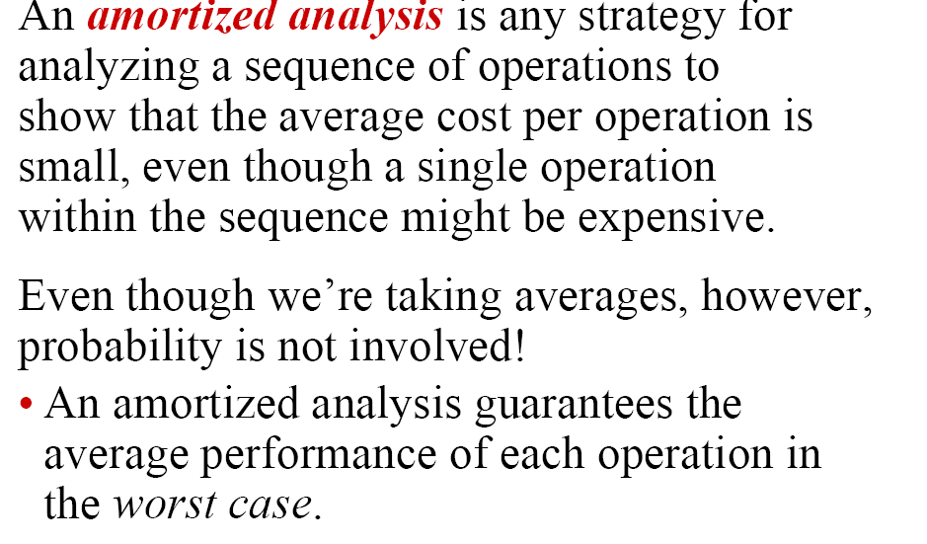
Amortized Analysis (1)

Slide 3

Amortized Analysis (2)
It is a kind of analysis method for a sequence of related operations on a specific data structure.
The total cost of a sequence of n operations is the function of n (length of sequence instead of input of data structure)
It provides an insight for a data structure where various algorithms work on and could help design a data structure with better time and space performance.

Slide 4
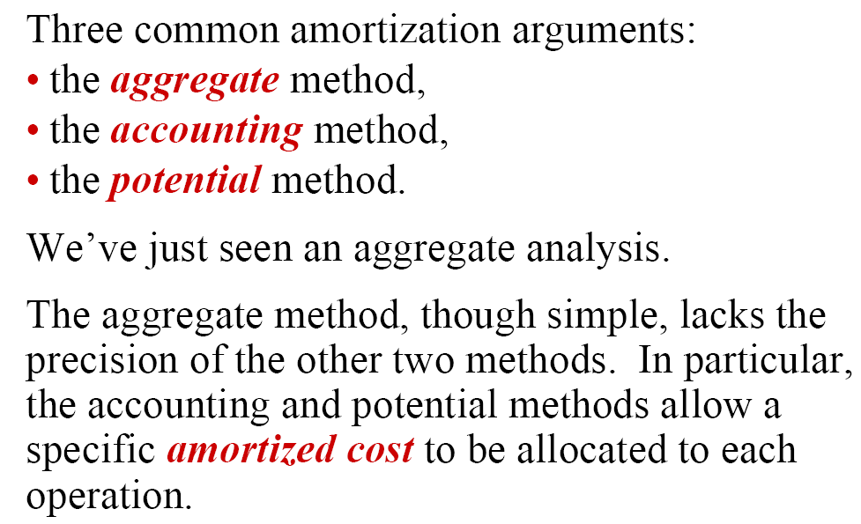

Slide 5
Three techniques used in Amortized Analysis
Aggregate Analysis
  Determine an upper bound T(n) on the total cost of a sequence of n operations
  The average cost per operation is T(n)/n
Accounting method
  When there is more than one type of operation, each type of operation may have a different amortized cost.
  Overcharges some operations early in the sequence and used later
Potential method
  Maintain the credit as the “potential energy” of the data structure as whole in stead of associating with individual objects

Slide 6

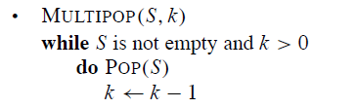
Example (1)

Slide 7
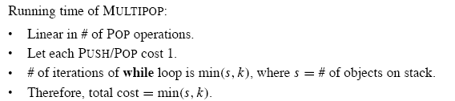
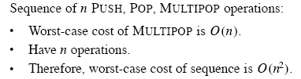
Analysis

Slide 8
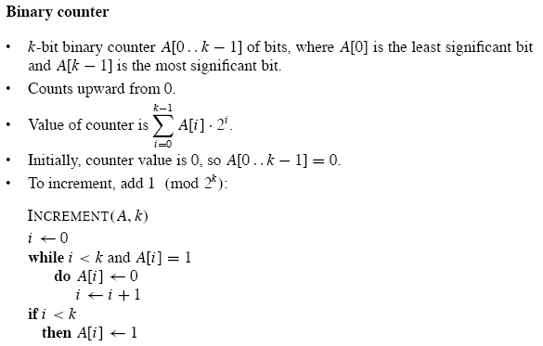
Example (2)

Slide 9
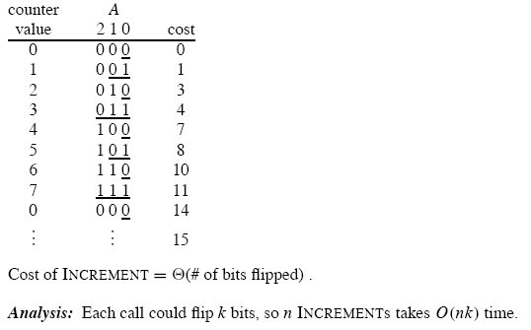
Continue

Slide 10
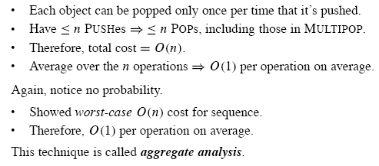
Aggregate Analysis (1)
Using aggregate analysis, we can obtain a better upper bound that considers entire sequence of n operations. While a single MULTIPOP operation can be expensive, any sequence of n PUSH, POP, MULTIPOP on an initially empty stack can cost at most O(n)

Slide 11
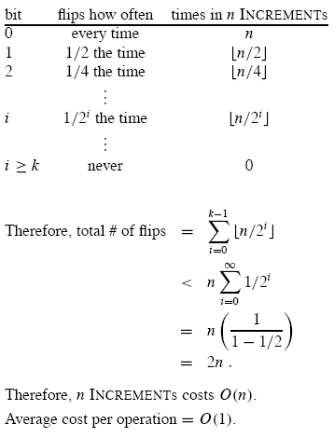
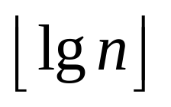

Slide 12
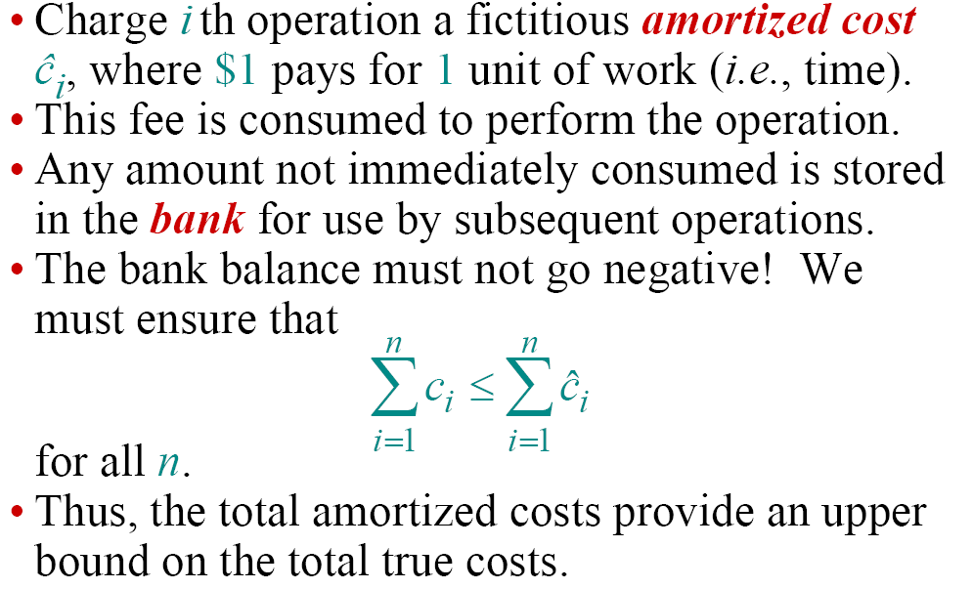
Accounting Method(1)

Slide 13
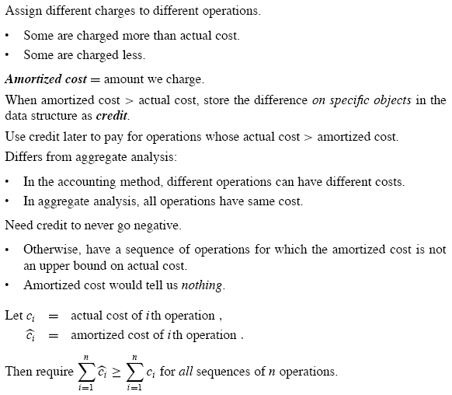

Slide 14
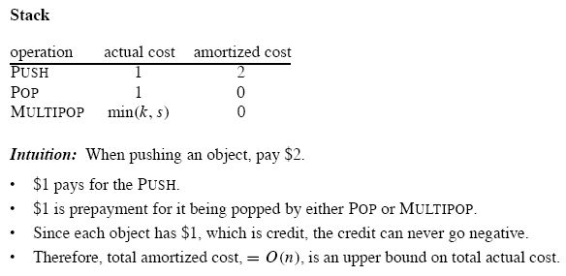
Stack Example

Slide 15
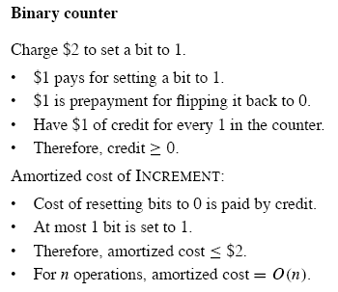
Binary Counter

Slide 16
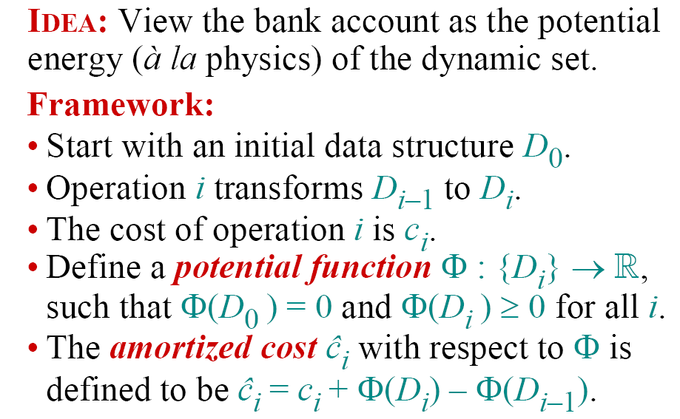
Potential Method (1)

Slide 17
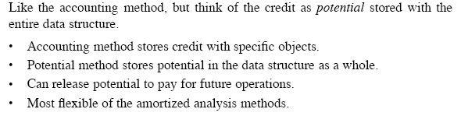
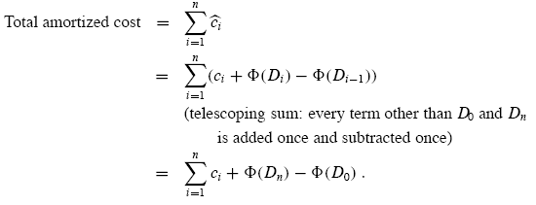
Potential Method(2)

Slide 18
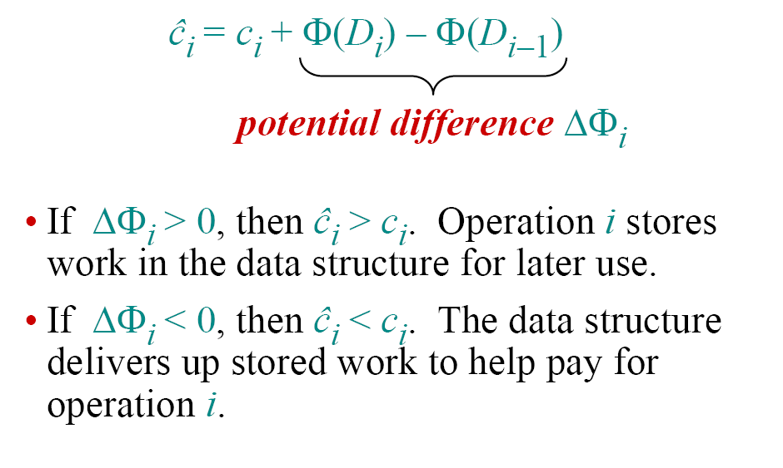
Understanding the Potential Method

Slide 19
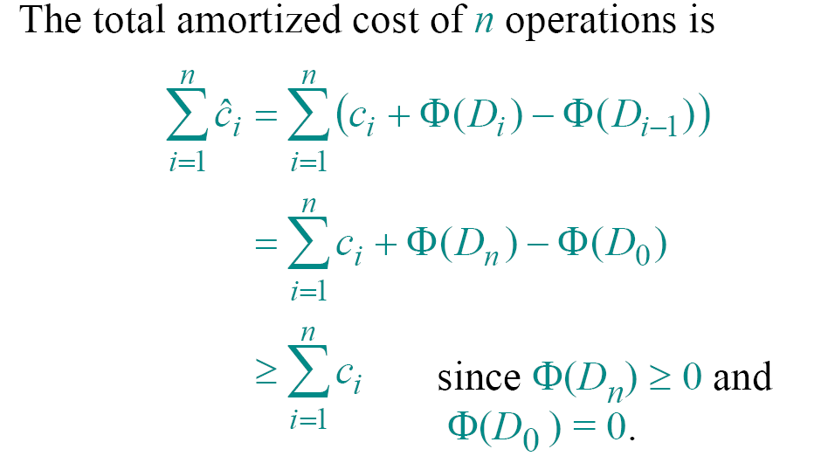
The Amortized Costs bound the true costs

Slide 20
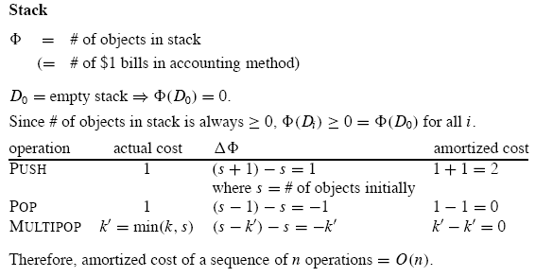
Stack Example

Slide 21
